Slide 1
Date-A-Scientist Project
Machine Learning Fundamentals
Niklas Cremer
11th May 2019

Slide 2
Table of contents
Exploration of the dataset
My models and augmentation of dataset
Classification models
Regression models
Conclusions & further work

Slide 3
Exploration of the dataset

Slide 4
Exploration of the Dataset
Fun observations:
Two outliers in terms of Age: 1x at 109 years and 1x at 110 Years
Mean age for the different sexual orientations
Straight & gay: both 32 years, while …
Bisexual: 29 years

Slide 5
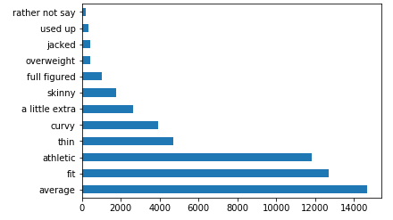
Exploration of the Dataset
65,4 % of the people in the dataset describe themselves as either average, fit or athletic. So, either they are pushing the truth a bit or overweight people do sign up as much for the dating website.

Slide 6
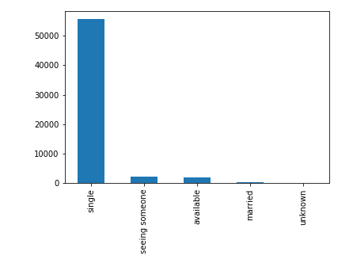
Exploration of the Dataset
Not everybody is single or available
2‘064 people are seeing someone
310 people are married
10 people stated “unknown”

Slide 7
My models and augmentation of the dataset

Slide 8
My models and augmentation of dataset
Classification:
Predict if people are vegetarian/vegan or something else
Regression:
Predict age of people
New columns:
Diet: grouped them into „vegetarian/vegan“ and „non_veg“
Frequency_count: „vegetarian“ and „vegan“ (assumption that vegetarians/vegans like to talk about their diet preference)

Slide 9
Classification models

Slide 10
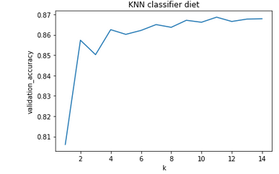
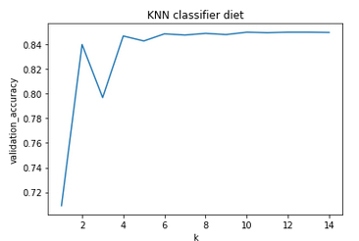
1st Classifier (vegan/vegetarian or other)
K-Nearest Neighbor Classifier
KNN (model 1)
Features: income, age and frequency_veg
K = 11
KNN (model 2)
Features: income and age
K = 4

Slide 11
1st Classifier(vegan/vegetarian or other)
Model 1 has one more feature and a higher k which makes the model more complex and potentially prone to overfitting, but it greatly improves the performance metrics (especially recall and precision)
The first version of frequency_veg counted the words „environment“ and „animal“. Changing those words made the variable significant enough to be included in the model
 | Accuracy | Recall | Precision
Model 1 | 86.86 % | 60.31 % | 78.60 %
Model 2 | 84.70 % | 50.15 % | 53.62 %

Slide 12
2nd classifier (vegan/vegetarian or other)
Naives-Bayes Classifier
Features: income, age and frequency_veg
This model does not perform as well as the KNN (model 1)
Interesting observation: the performance metrics do not change when I change the feature data. Do you know why?
 | Accuracy | Recall | Precision
KNN (model 1) | 86.86 % | 60.31 % | 78.60 %
Naives Bayes | 84.98 % | 50.00 % | 42.49 %

Slide 13
Regression models

Slide 14
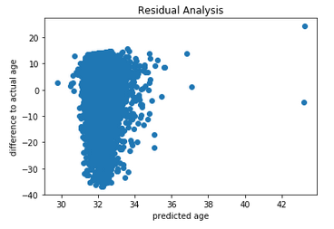
1st Regression model
Multiple Linear Regression to predict the age
Feature data: height, frequency_I_Me, income
This resulted in a close to 0 test score, i.e. that the model explains almost none of the variation in the y variable (age).
A simpler model with income as the only feature (income has the strongest coefficient) does not significantly improve the score
The residual analysis shows that my model is only predicting ages around 32, while the dataset clearly has also older people.
Not a very good model!

Slide 15
2nd Regression model
K-Nearest Neighbor Regressor
Feature data: height, frequency_I_Me, income
This resulted in a better test score than the Multiple Linear Regression model, …
… but the residual analysis (see next page)
 | Train score | Test score
Multiple Linear Regression | 0.37 % | 0.46 %
K-Nearest Neighbor Regression | 48.90 % | -21.89 %

Slide 16
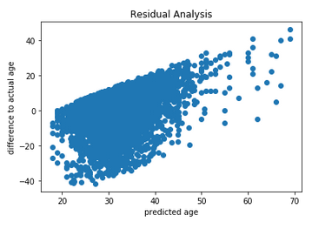
2nd Regression model
K-Nearest Neighbor Regressor
… but the residual analysis shows that the model still overestimates the amount of young people in the test dataset. There has to be another feature(s) that better explains the age of the people in the dataset.

Slide 17
Conclusion & Further work

Slide 18
Conclusions
Classifier
The KNN classifier to predict diet preferences worked better than the Naives-Bayes classifier (using the same feature data). The KNN classifier performed reasonably well in terms of accurcy, recall and precision. Overall, a good starting point for a classifier to predict dietary preferences. My assumption that vegetarians/vegans like to talk about their dietary preferences seems to be correct.
Regressor
The KNN regressor to predict the age worked better than the multiple linear regression, but both models revealed in the residual analysis that they overestimated the amount of young people.

Slide 19
Further work
Classifier
The performance metrics of the Naives Bayes classifier did not change even though I changed the feature variables. This has to be further investigated. On Slack, you recommended me to try different variables (I did) and different scaling preprocessors (I have not done that yet): which scaling preprocessors would you recommend?
In general, how would you find the best feature variables? Is there something similar to the .coef_ function for multiple linear regressions that indicate the impact several variables?
Regressor
It seems clear that I am missing one or several features that is significant for older age people. I would need to go back and explore the dataset some more.

Slide 20
Further work
General
Working with K-Nearest Neighbor: What is the correct approach? Do you first try to find the best feature variables by looking at performance metrics (accuracy, recall, precision,…) and then you find the best number for k given your feature variables?
I have not used all columns of the dataset (e.g. job, ethnicity, education: I would need to map them into number values and/or group them into categories (e.g. higher education, drop-out, high-school, …) to be able to use the,)

